Slide 1

5502 Group #1 Midterm Report
Brain Tumor Classification Using CNNs and Grad-CAM
Notes:
“Good afternoon, everyone. I’m [] from Team DET.
Today we’ll show how we’re enhancing atomistic LLMs—by integrating Graph Neural Networks—to accelerate innovation in renewable energy and chemical research.
Executive summary: In ten weeks, we’ll deliver a prototype that overcomes current LLM limitations on molecular data, driving faster, more cost‑effective discoveries for OracleLens.”

Slide 2
1. Introduction
Objectives
Develop an automated CNN model for accurate brain tumor classification.
Enhance image interpretability using CLAHE (Contrast Limited Adaptive Histogram Equalization).
Evaluate model performance with metrics such as accuracy, precision, recall, and F1-score.
Incorporate Grad-CAM to visualize regions contributing to predictions, ensuring clinical explainability.
Notes:
“Based on our findings:
Prioritize data curation—clean, well‑labeled inputs remain vital.
Interpretability—build token‑erasure or attention‑visualization tools for end users.
Modular design—keep GNN and transformer components loosely coupled for future swaps.
Next steps:
Integrate experimental assay data for tighter real‑world feedback.
Explore automated workflow pipelines so OracleLens can retrain models as new data arrives.”

Slide 3
2. Dataset Description – Data Source
Data Source:
The dataset consists of MRI scans from Kaggle, organized into:
Training Set: Contains labeled images (5,712 samples) across four categories.
Testing Set: Contains 1,311 images for validation.
Classes:
Glioma: Tumors arising from glial cells.
Meningioma: Tumors originating in the meninges.
Pituitary: Tumors in the pituitary gland.
No Tumor: Normal brain scans.
Notes:
“Based on our findings:
Prioritize data curation—clean, well‑labeled inputs remain vital.
Interpretability—build token‑erasure or attention‑visualization tools for end users.
Modular design—keep GNN and transformer components loosely coupled for future swaps.
Next steps:
Integrate experimental assay data for tighter real‑world feedback.
Explore automated workflow pipelines so OracleLens can retrain models as new data arrives.”

Slide 4
2. Dataset Description – Data Distribution
Class | Training Samples | Testing Samples
Glioma | 1,321 | 300
Meningioma | 1,339 | 306
No Tumor | 1,595 | 405
Pituitary | 1,457 | 300
Notes:
“Based on our findings:
Prioritize data curation—clean, well‑labeled inputs remain vital.
Interpretability—build token‑erasure or attention‑visualization tools for end users.
Modular design—keep GNN and transformer components loosely coupled for future swaps.
Next steps:
Integrate experimental assay data for tighter real‑world feedback.
Explore automated workflow pipelines so OracleLens can retrain models as new data arrives.”

Slide 5
3. Model Architecture
CNN Structure
The CNN consists of the following layers:
Convolutional Blocks:
Three blocks of Conv2D + MaxPooling + Dropout for feature extraction.
Filters: 32 → 64 → 128.
ReLU activation.
Dense Layers:
Flatten layer to transition from spatial to dense features.
Fully connected layers (128 neurons) with Dropout (0.5) for regularization.
Softmax output for 4-class classification.
Loss Function: sparse_categorical_crossentropy Optimizer: Adam Metrics: Accuracy
Notes:
“Based on our findings:
Prioritize data curation—clean, well‑labeled inputs remain vital.
Interpretability—build token‑erasure or attention‑visualization tools for end users.
Modular design—keep GNN and transformer components loosely coupled for future swaps.
Next steps:
Integrate experimental assay data for tighter real‑world feedback.
Explore automated workflow pipelines so OracleLens can retrain models as new data arrives.”

Slide 6
4. Methodology
Preprocessing Steps
Grayscale Conversion: RGB → Single-channel for efficiency.
Resizing: All images standardized to 150×150 pixels.
CLAHE Enhancement: Adaptive contrast improvement.
Normalization: Pixel values scaled to [0, 1].
Model Training
Epochs: 10
Batch Size: 32
Validation Split: 20% held-out for validation.
Notes:
“Based on our findings:
Prioritize data curation—clean, well‑labeled inputs remain vital.
Interpretability—build token‑erasure or attention‑visualization tools for end users.
Modular design—keep GNN and transformer components loosely coupled for future swaps.
Next steps:
Integrate experimental assay data for tighter real‑world feedback.
Explore automated workflow pipelines so OracleLens can retrain models as new data arrives.”

Slide 7
5. Results – Training Performance
Epoch | Training Accuracy | Validation Accuracy | Training Loss | Validation Loss
1 | 54.12% | 68.73% | 1.0588 | 0.6899
10 | 95.78% | 93.59% | 0.1186 | 0.1685
Final Test Metrics:
Overall Accuracy: 94%
Precision (Macro Avg): 0.94
Recall (Macro Avg): 0.93
F1-Score (Macro Avg): 0.93
Notes:
“This table shows our learning curve: we started with 54% training accuracy and 69% validation accuracy in epoch 1, and by epoch 10 reached 95.8% training and 93.6% validation accuracy with low loss.
On the held-out test set, we achieved an overall accuracy of 94%, with macro-averaged precision 0.94, recall 0.93, and F1-score 0.93. These results indicate strong generalization and balanced class performance.”

Slide 8
5. Results – Class-Specific Performance
Class | Precision | Recall | F1-Score | Support
Glioma | 0.95 | 0.92 | 0.93 | 300
Meningioma | 0.92 | 0.81 | 0.86 | 306
No Tumor | 0.93 | 1.00 | 0.96 | 405
Pituitary | 0.96 | 0.99 | 0.97 | 300
Notes:
“This table presents precision, recall, and F1-score for each class on the test set. Notice that meningioma shows the lowest recall (81%), indicating some misclassification into glioma or healthy scans. All other classes exceed 92% recall, demonstrating strong performance overall.”

Slide 9
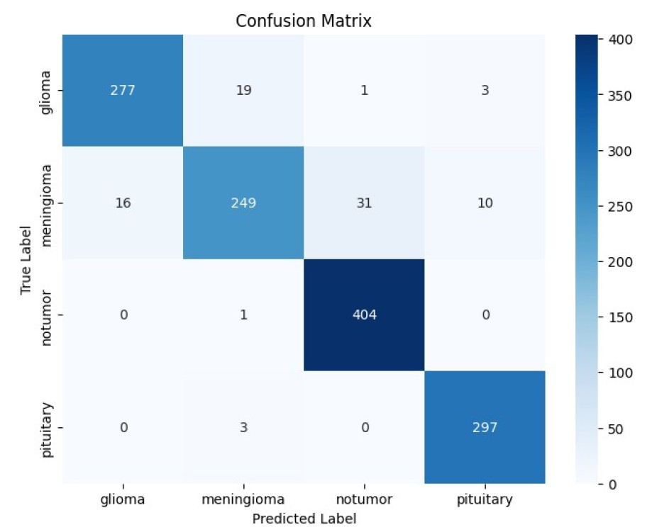
5. Results – Confusion Matrix
Key Observation: Meningioma had lower recall (81%), with some confusion with glioma and no-tumor classes.
Notes:
“This confusion matrix shows strong performance on glioma, no-tumor, and pituitary classes, with most errors occurring in meningioma (81% recall). Meningioma scans are sometimes misclassified as glioma or healthy. To address this, we’ll apply targeted augmentation and class-weighted training. Next, we’ll review learning curves and Grad-CAM visualizations.”

Slide 10
6. Visualizations - Accuracy & Loss Curves
Training Curves
No Overfitting: Validation accuracy closely follows training accuracy.
Grad-CAM Interpretability
Grad-CAM Output
The model accurately identifies tumor-localized regions.
Highlights model transparency in clinical decision-making.
Notes:
“Here we plot the training and validation accuracy and loss over all 10 epochs. You can see that validation accuracy closely follows training accuracy, and both loss curves decline smoothly—indicating stable learning with no overfitting.
Below, our Grad-CAM outputs overlay heatmaps on sample MRIs. Notice how the model consistently focuses on the true tumor regions, demonstrating transparency and building confidence in its clinical applicability.”

Slide 11
7. Interpretation and Discussion
Key Findings
The CNN achieved 94% accuracy, demonstrating strong generalization.
Grad-CAM confirmed that the model focuses on medically relevant regions for classification.
Meningioma misclassifications suggest potential areas for improvement.
Challenges & Solutions
Challenge | Solution
Low contrast in MRI scans | CLAHE enhancement improved feature visibility.
Class imbalance | Future work could incorporate weighted loss or augmentation.
Model explainability | Grad-CAM helps build clinician trust.
Notes:
“This slide summarizes our key findings and how we addressed major challenges.
Key Findings:
Achieved 94% accuracy, demonstrating strong generalization.
Grad-CAM confirms the model focuses on medically relevant regions.
Meningioma misclassifications highlight where performance can improve.
Challenges & Solutions:
Low contrast: Solved with CLAHE preprocessing.
Class imbalance: Will use weighted loss or augmented sampling in future work.
Model explainability: Grad-CAM provides transparency to build clinician trust.”

Slide 12
8. Conclusion
This project developed an accurate (94%) and interpretable CNN model for brain tumor classification. Key contributions include:
Preprocessing with CLAHE for improved image quality.
Robust CNN architecture with regularization to prevent overfitting.
Grad-CAM explanations for clinical interpretability.
Future Work:
Data Augmentation for better meningioma recall.
Transfer Learning with ResNet/VGG for higher accuracy.
Larger, multi-center datasets for improved generalizability.
Notes:
“This slide wraps up our midterm work and lays out next steps.
Contributions: We developed a CNN that’s both 94% accurate and interpretable, thanks to:
CLAHE preprocessing for better lesion visibility
A robust three-block CNN with dropout to prevent overfitting
Grad-CAM explanations to highlight clinically relevant regions
Future Work:
Data augmentation—especially for meningioma—to boost recall
Transfer learning using ResNet/VGG backbones for richer feature extraction and higher accuracy
Larger, multi-center datasets to improve generalizability
These steps will help address our current weak points and move toward a clinically deployable solution.”

Slide 13
9. References
Selvaraju, R. R., et al. "Grad-CAM: Visual Explanations from Deep Networks." ICCV 2017.
CLAHE: https://docs.opencv.org/3.4/d5/daf/tutorial_py_histogram_equalization.html
Dataset Source: Kaggle Brain Tumor MRI Dataset. https://www.kaggle.com/datasets/masoudnickparvar/brain-tumor-mri-dataset
Notes:
“Our work builds on:
Selvaraju et al.’s Grad-CAM paper (ICCV 2017).
OpenCV’s CLAHE implementation.
The Kaggle Brain Tumor MRI dataset.
Feel free to consult these sources for implementation details.”

Slide 14
Group 1 Members
Jawwad Khalil Ahmed
Eric Efon
Daniel Mehta
Thomas Nash
Jeffrey Ng
Notes:
“Thank you for your attention. We’re happy to take any questions!
Team: Jawwad Khalil Ahmed, Eric Efon, Daniel Mehta, Thomas Nash, and myself, Jeffrey Ng.”

